Slide 1


PRINCIPLES OF ARTIFICIAL INTELLIGENCE
SOF106
DR SHAMINI RAJA KUMARAN
LAB INTRODUCTION
www.website.com
PREPARED BY DR SHAMINI

Slide 2
XMUM VISION
Xiamen University Malaysia aspires to become a university with a distinct global outlook, featuring first-class teaching and research, and embracing cultural diversity.
XMUM MISSION
To nurture young talents with dignity and wisdom, turning them into fine citizens of the region who will contribute to the prosperity of the people and social progress of Malaysia, China and Southeast Asia.To nurture young talents with dignity and wisdom, turning them into fine citizens of the region who will contribute to the prosperity of the people and social progress of Malaysia, China and Southeast Asia.

Slide 3
Course Overview (Lab)
Installation of Machine Learning Software (all other subfiles)
Introduction of the Software (example with data)

Slide 4
TEACHING TEMPLATE
A variety of teaching and learning strategies are used throughout the course for lab, including:
Tutorial
Powerpoint/PDF will be uploaded time to time using Moodle platform.
Chats through Microsoft Team and update extra materials during class.
Consultations with lecturer whenever you need assistance (Fix your appointment through email (shamini.rajakumaran@xmu.edu.my)).

Slide 5
COURSE SYLABBUS
PART 1: Introduction to artificial intelligence
PART 2: Problem solving and search technology
PART 3: Graph Search Strategies
PART 4: Evolutionary search
PART 5: Swarm Intelligence
PART 6: Memetic algorithms
PART 7: Machine learning
PART 8: Artificial Neural Network
PART 9: Data mining and knowledge discovery
Your lab class will be simultaneous with the course sylabbus

Slide 6
COURSE SYLABBUS
You can contact me through :
Email : shamini.rajakumaran@xmu.edu.my
Email me anytime/Message me through Microsoft Teams: I’ll respond during working hours (Monday-Friday (8.00 am-5.00pm)).
Schedule with me meeting for any consultations during working hours.
A1-462

Slide 7
INTRODUCING WEKA
Collection of ML algorithms - open-source Java package
Site:
https://www.cs.waikato.ac.nz/ml/weka/
Documentation (Aksenova, 2004) :
http://people.sabanciuniv.edu/berrin/cs512/lectures/WEKA/WEKA%20Explorer%20Tutorial-REFERENCE.pdf
Schemes for classification:
decision trees, rule learners, naive Bayes, decision tables, locally weighted regression, SVMs, instance-based learners, logistic regression, voted perceptrons, multi-layer perceptron
For classification, Weka allows train/test split or Cross-fold validation
Schemes for clustering: EM and Cobweb

Slide 8
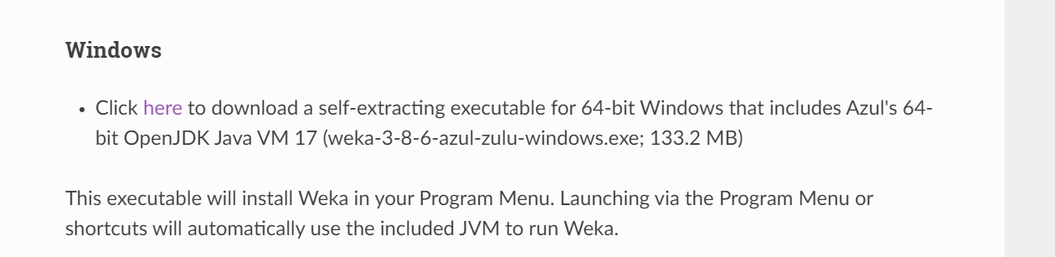
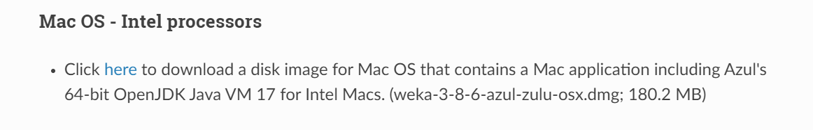
INSTALLING WEKA
https://waikato.github.io/weka-wiki/downloading_weka/ OR https://sourceforge.net/projects/weka/

Slide 9
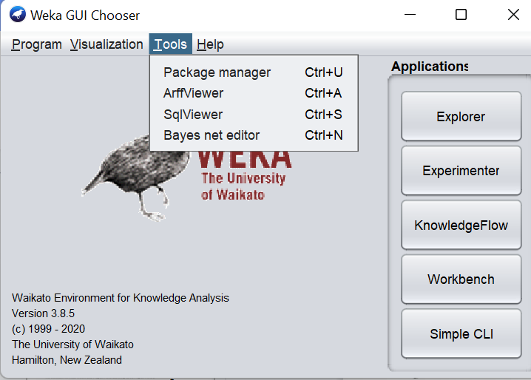
INSTALLING WEKA
Tools to install :

Slide 10
INSTALLING WEKA
Tools to install :

Slide 11
INTRODUCING WEKA - .arff (data set)
Require declarations of @RELATION, @ATTRIBUTE and @DATA
@RELATION declaration associates a name with the dataset
@RELATION <relation-name>
@ATTRIBUTE declaration specifies the name and type of an attribute
@ATTRIBUTE <attribute-name> <datatype>
Datatype can be numeric, nominal, string or date
@ATTRIBUTE sepallength NUMERIC
@ATTRIBUTE petalwidth NUMERIC
@ATTRIBUTE class {Setosa,Versicolor,Virginica}
@DATA declaration is a single line denoting the start of the data
segment
Missing values are represented by ?
@DATA
1.4, 0.2, Setosa
1.4, ?, Versicolor

Slide 12
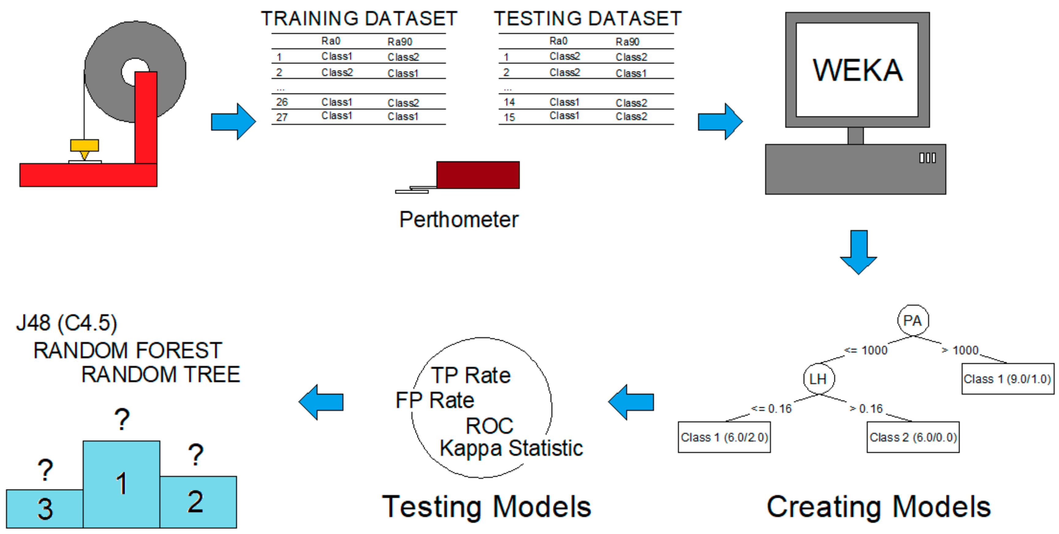
INTRODUCING WEKA
Notes:
数据要有特征值。

Slide 13
INTRODUCING WEKA
Let’s use a sample data through Weka !

Slide 14
THANK YOU
www.website.com
PREPARED BY DR SHAMINI

